Slide 1
1. Basic Mendelian genetics: Mendel’s first three postulates
Monohybrid Testcross
Dihybrid Cross
Independent Assortment
Trihybrid Cross
2. Molecular basis of Mendel’s postulates
3. Probability: product law and sum law

Slide 2
I. Conditional probability
II. Binomial theorum
Chi-square and statistical analysis

Slide 3
Conditional probability
What is the likelihood that one outcome will occur, given a particular condition? Answer = probability, p_{c}
ex. In the F2 of Mendel’s monohybrid cross between tall and dwarf plants, what is the probability that a tall plant is heterozygous?
condition: consider only tall F2 plants
question: of any F2 tall plant, what is the probability of it being heterozygous

Slide 4
How do we solve for a conditional probability, p_{c}?
Consider 2 probabilities: 1) the outcome of interest, and
2) the condition that includes the outcome
Example: In the F2 of Mendel’s monohybrid cross between tall and dwarf plants, what is the probability that a tall plant is heterozygous?
probability an F2 plant is heterozygous p_{a} = 1/2
2) probability of the condition, being tall p_{b} = 3/4
p_{c} = p_{a}/ p_{b}
= (1/2)/ (3/4)
= (1/2) x (4/3)
= 4/6
= 2/3

Slide 5
Applications for conditional probabilities
Genetic counseling:
What is the probability that an unaffected sibling of a brother or sister expressing a recessive disorder is a carrier (a heterozygote)?
p_{a} = probability that unaffected sibling is a heterozygote = 1/2
p_{b} = probability that sibling is unaffected = 3/4
p_{c} = p_{a} / p_{b} = 2/3

Slide 6
The Binomial Theorem
Used to determine the probability of a particular combination, rather than going through all possibilities.
Example 1: What is the probability that in a family of 4 children, 2 will be male and 2 female?
    3 distinct methods to answer this question

Slide 7
Brute Force Method: Going through all the possibilities - method 1
Ex. 1: What is the probability that in a family of 4 children, 2 will be male and 2 female?
p (MMFF) = (1/2)(1/2)(1/2)(1/2) = 1/16 or
p (MFFM) = 1/16 or
p (MFMF) = 1/16 or
p (FMFM) = 1/16 or
p (FFMM) = 1/16 or
p (FMMF) = 1/16
Sum = 6/16 = 3/8

Slide 8
Use of Binomial Theorem - method 2
When one of two outcomes is possible during each of a succession of trials, (a + b)^{n} = 1
  where a and b are probabilities of two possible outcomes and n = # of trials.
Expand the binomial:
Ex. 1: What is the probability that in a family of 4 children, 2 will be male and 2 female?
  Let a = P_{male} = 1/2
  Let b = P_{female} = 1/2
  n = 4
(a + b)⁴ = a⁴ + 4a³b + 6a²b² + 4ab³ + b⁴ (the numerical coefficients are determined using Pascal’s triangle
a and b each occur twice, so use: p = 6a²b² = 6(1/2)²(1/2)² = 6(1/2)⁴ = 6(1/16) = 6/16 = 3/8

Slide 9
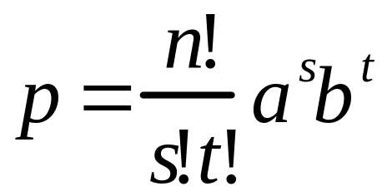
General Formula -method 3
The generalized formula is:
Where n = total number of events,
s = number of times outcome a occurs,
t = number of times outcome b occurs;
! means factorial, so 4! = 4 X 3 X 2 X 1, etc. Note 0! = 1.
For our example 1, What is the probability that in a family of 4 children, 2 will be male and 2 female? n= 4, s= 2, t=2, a= 1/2, b= 1/2
p = (4!/2!2!)(1/2)²(1/2)² = ((4*3*2*1)/(2)(2))(1/2)⁴= (24/4)(1/16) = 6/16 = 3/8

Slide 10
Binomial Example 2
What is the probability that in a family of 4 children, 3 are male and 1 is female?
Let a = p_{male} = 1/2, b = p_{female} = 1/2, n = 4
(a + b)⁴ = a⁴ + 4a³b + 6a²b² + 4ab³ + b⁴
p = 4a³b = 4(1/2)³(1/2) = 1/4

Slide 11
The Chi Square Test
A statistical method used to determine goodness of fit
  Goodness of fit refers to how close the observed data are to those predicted from a hypothesis
  The chi square test does not prove that a hypothesis is correct
    It evaluates to what extent the data and the hypothesis have a good fit

Slide 12
Statistics and chi-square
How do you know if your data fits your hypothesis? (3:1, 9:3:3:1, etc.)
For example, suppose you get the following data in a monohybrid cross:
Phenotype Data Expected (3:1)
A 760 750
a 240 250
Total 1000 1000
Is the difference between your data and the expected ratio due to chance deviation or is it significant?

Slide 13
Two points about chance deviation
Outcomes of segregation, independent assortment, and fertilization, like coin tossing, are subject to random fluctuations.
As sample size increases, the average deviation from the expected fraction or ratio should decrease. Therefore, a larger sample size reduces the impact of chance deviation on the final outcome.

Slide 14
The null hypothesis
The assumption that the data will fit a given ratio, such as 3:1 is the null hypothesis.
It assumes that there is no real difference between the measured values and the predicted values.
Use statistical analysis to evaluate the validity of the null hypothesis.
  If rejected, the deviation from the expected is NOT due to chance alone and you must reexamine your assumptions.
  If failed to be rejected, then observed deviations can be attributed to chance.

Slide 15
Process of using chi-square analysis to test goodness of fit
Establish a null hypothesis: 1:1, 3:1, etc.
Plug data into the chi-square formula.
Determine if null hypothesis is either (a) rejected or (b) not rejected.
If rejected, propose alternate hypothesis.
Chi-square analysis factors in (a) deviation from expected result and (b) sample size to give measure of goodness of fit of the data.

Slide 16
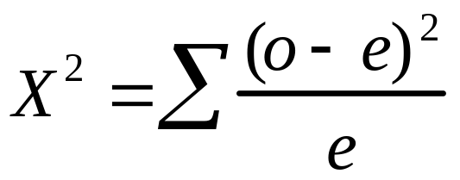
Chi-square formula
where o = observed value for a given category,
e = expected value for a given category, and sigma is the sum of the calculated values for each category of the ratio
Once X² is determined, it is converted to a probability value (p) using the degrees of freedom (df) = n- 1 where n = the number of different categories for the outcome.

Slide 17
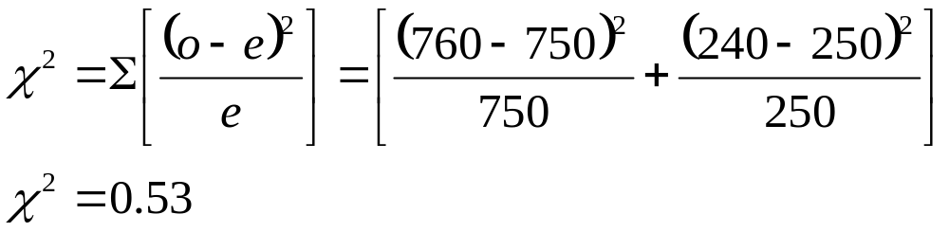
Chi-square - Example 1
Phenotype Expected Observed
A 750 760
a 250 240
1000 1000
Null Hypothesis: Data fit a 3:1 ratio.
degrees of freedom = (number of categories - 1) = 2 - 1 = 1

Slide 18
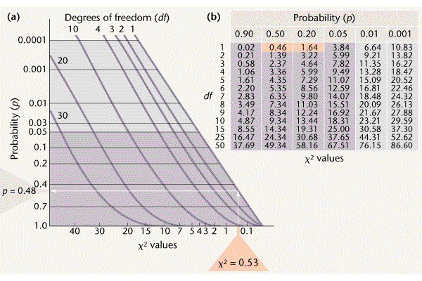
X² Table and Graph
Unlikely:
Reject hypothesis
Likely:
Do not reject
Hypothesis
0.50 > p > 0.20
Figure 3.12

Slide 19
Interpretation of p
0.05 is a commonly-accepted cut-off point.
p > 0.05 means that the probability is greater than 5% that the observed deviation is due to chance alone; therefore the null hypothesis is not rejected.
p < 0.05 means that the probability is less than 5% that observed deviation is due to chance alone; therefore null hypothesis is rejected. Reassess assumptions, propose a new hypothesis.

Slide 20
Conclusions:
X² less than 3.84 means that we accept the Null Hypothesis (3:1 ratio).
In our example, p = 0.48 (p > 0.05) means that we accept the Null Hypothesis (3:1 ratio).
This means we expect the data to vary from expectations this much or more 48% of the time.
Conversely, 52% of the repeats would show less deviation as a result of chance than initially observed.

Slide 21
Consider the following example in Drosophila melanogaster
Gene affecting wing shape
  c⁺ = Normal wing
  c = Curved wing
Gene affecting body color
  e⁺ = Normal (gray)
  e = ebony
  The wild-type allele is designated with a + sign
  Recessive mutant alleles are designated with lowercase letters
The Cross:
  A cross is made between two true-breeding flies (c⁺c⁺e⁺e⁺ and ccee). The flies of the F₁ generation are then allowed to mate with each other to produce an F₂ generation.

Slide 22
The outcome
  F₁ generation
    All offspring have straight wings and gray bodies
  F₂ generation
    193 straight wings, gray bodies
    69 straight wings, ebony bodies
    64 curved wings, gray bodies
    26 curved wings, ebony bodies
    352 total flies
Applying the chi square test
  Step 1: Propose a null hypothesis (Ho) that allows us to calculate the expected values based on Mendel’s laws
    The two traits are independently assorting

Slide 23
  Step 2: Calculate the expected values of the four phenotypes, based on the hypothesis
    According to our hypothesis, there should be a 9:3:3:1 ratio on the F₂ generation
Phenotype | Expected probability | Expected number | Observed number
straight wings, gray bodies | 9/16 | 9/16 X 352 = 198 | 193
straight wings, ebony bodies | 3/16 | 3/16 X 352 = 66 | 64
curved wings, gray bodies | 3/16 | 3/16 X 352 = 66 | 62
curved wings, ebony bodies | 1/16 | 1/16 X 352 = 22 | 24

Slide 24
  Step 3: Apply the chi square formula
(O₁ – E₁)²
(O₂ – E₂)²
(O₃ – E₃)²
(O₄ – E₄)²
χ² =
+
+
+
E₁
E₂
E₃
E₄
(193 – 198)²
(69 – 66)²
(64 – 66)²
(26 – 22)²
χ² =
+
+
+
198
66
66
22
χ² = 0.13 + 0.14 + 0.06 + 0.73
Expected number | Observed number
198 | 193
66 | 64
66 | 62
22 | 24
χ² = 1.06

Slide 25
Step 4: Interpret the chi square value
  The calculated chi square value can be used to obtain probabilities, or P values, from a chi square table
    These probabilities allow us to determine the likelihood that the observed deviations are due to random chance alone
  Low chi square values indicate a high probability that the observed deviations could be due to random chance alone
  High chi square values indicate a low probability that the observed deviations are due to random chance alone
  If the chi square value results in a probability that is less than 0.05 (ie: less than 5%) it is considered statistically significant
    The hypothesis is rejected

Slide 26
Step 4: Interpret the chi square value
  Before we can use the chi square table, we have to determine the degrees of freedom (df)
    The df is a measure of the number of categories that are independent of each other
    If you know the 3 of the 4 categories you can deduce the 4th (total number of progeny – categories 1-3)
    df = n – 1
      where n = total number of categories
    In our experiment, there are four phenotypes/categories
      Therefore, df = 4 – 1 = 3

Slide 27
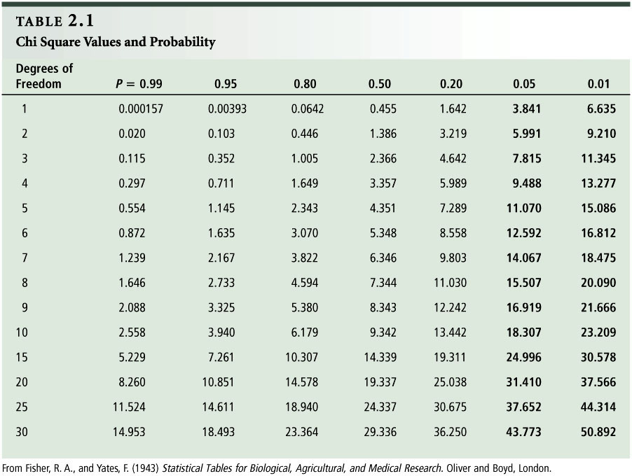
1.06

Slide 28
Step 4: Interpret the chi square value
  With df = 3, the chi square value of 1.06 is slightly greater than 1.005 (which corresponds to P-value = 0.80)
  P-value = 0.80 means that Chi-square values equal to or greater than 1.005 are expected to occur 80% of the time due to random chance alone; that is, when the null hypothesis is true.
  Therefore, it is quite probable that the deviations between the observed and expected values in this experiment can be explained by random sampling error and the null hypothesis is not rejected. What was the null hypothesis?

Slide 29
Summary
1. Genetic ratios are expressed as probabilities. Thus, deriving outcomes of genetic crosses relies on an understanding of laws of probability, in particular: the sum law, product law, conditional probability, and the binomial theorum.
2. Statistical analyses are used to test the validity of experimental outcomes. In genetics, some variation is expected, due to chance deviation.

